Slide 1



SGC Open Chemistry Networks
Aim: to discover chemical probes more quickly.
The SGC provides the biology (protein, assays).
Chemists worldwide provide the molecules.
All data and ideas freely shared in real time.
No protected IP, lots of freedom to operate.
Prof Matthew H. Todd
Head of SGC Open Chemistry Networks
Chair of Drug Discovery, University College London
@mattoddchem

Slide 2
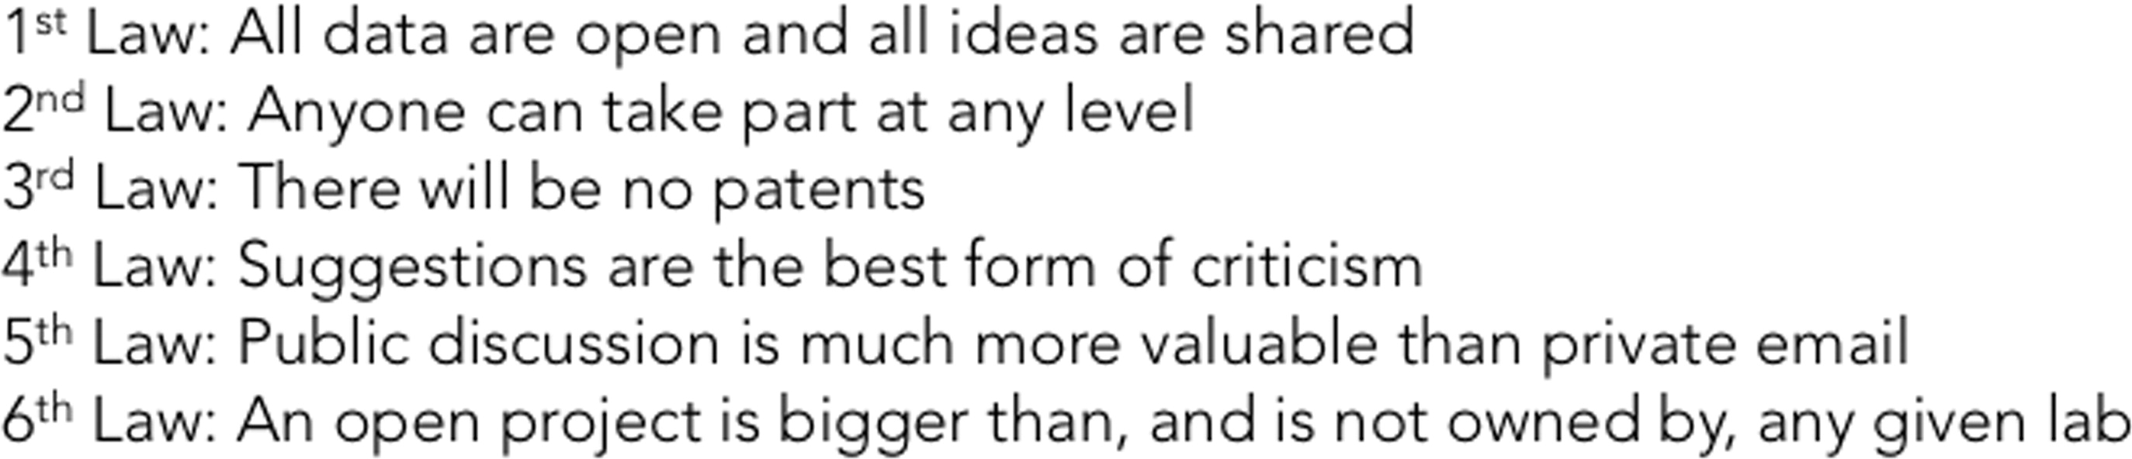
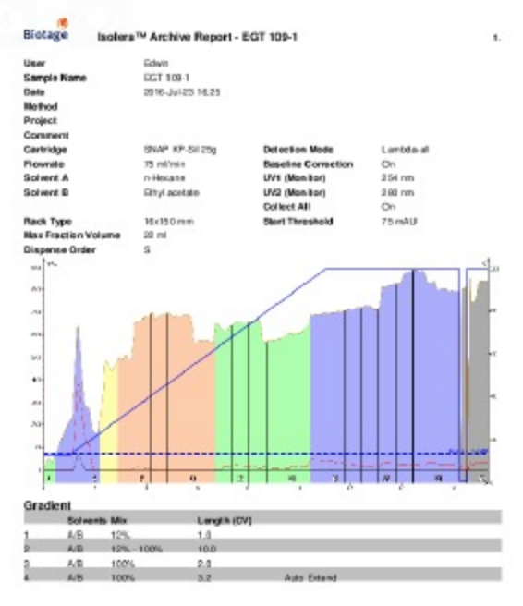
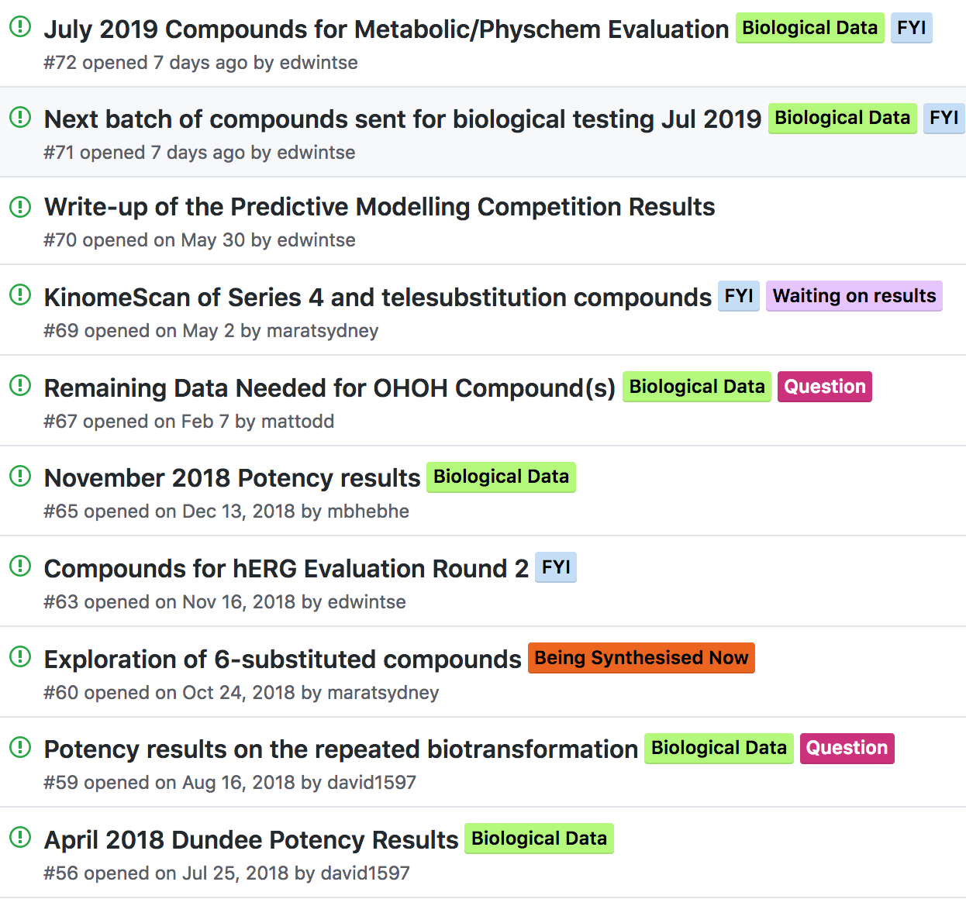
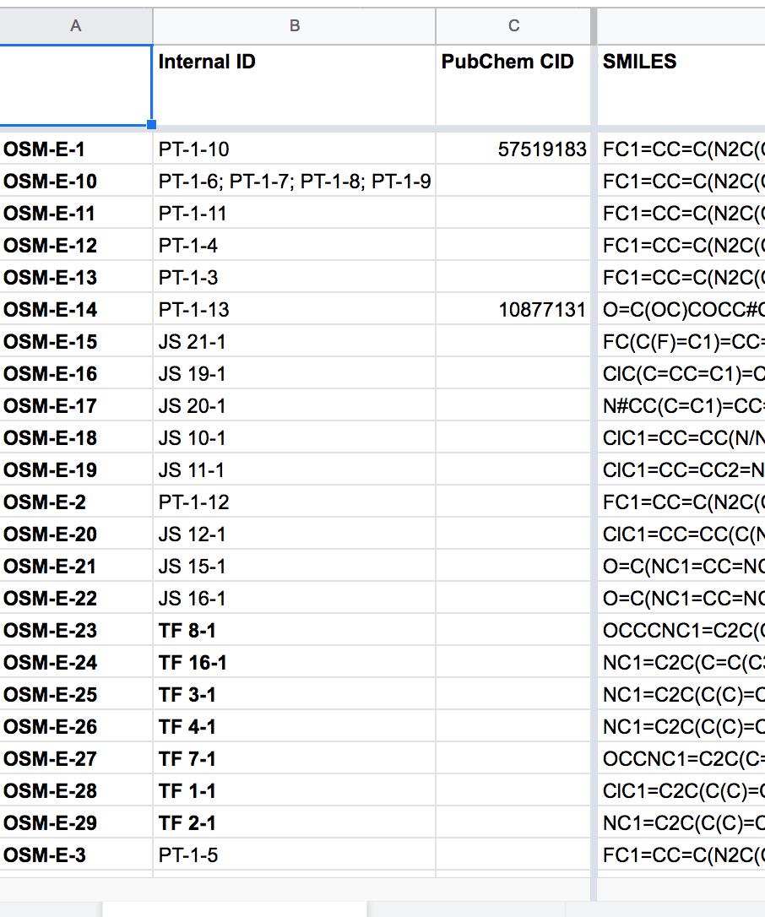
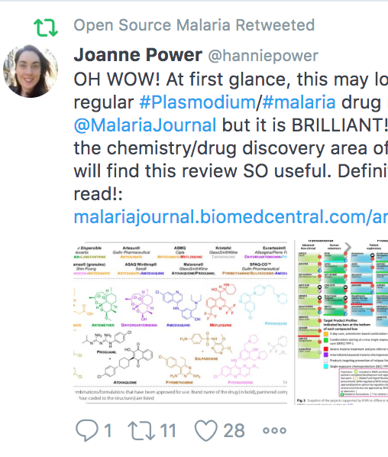
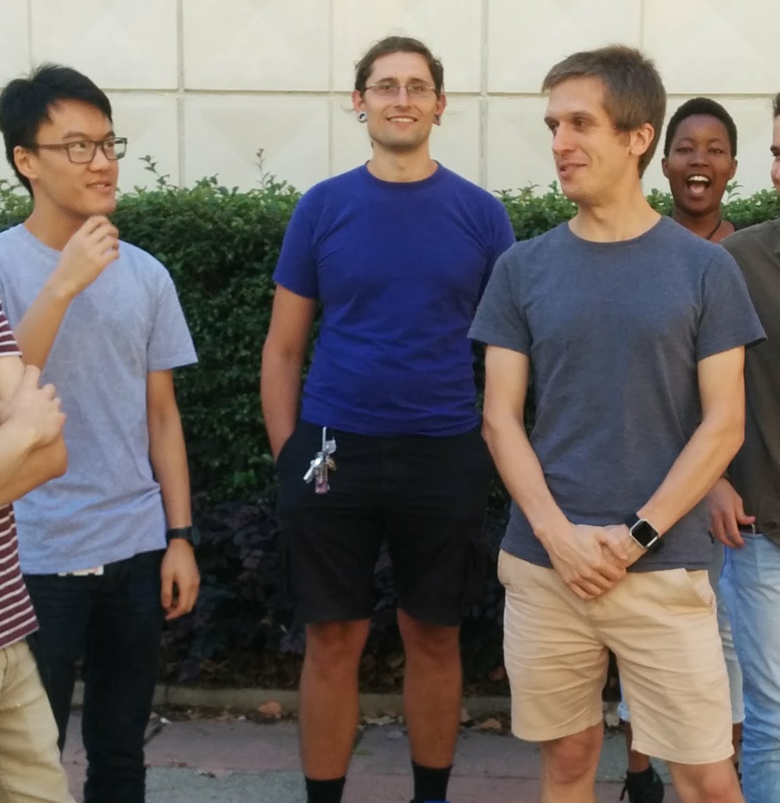
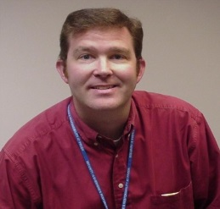
Rules and Components. Openness → Contributions
ChemMedChem, 2019, 14, 1804.
Licence: CC-BY-4.0: “You can do whatever you want with the data, including making money, provided you cite the project.”
Components
Contributions
Laboratory Notebooks
Public To Do Lists/Discussion
Open Data
Community
Students
Pharma

Slide 3
OCN Components include Student and Pharma Project Champions
Parent SGC website
Not community curated
Lists targets, status, rationale
RULES and LICENCE
Links out to project hubs
Raw Data
Managed by individuals
Electronic Lab Notebooks
Essential criteria:
1) Openness/licence; 2) Completeness
3) Permanence; 4) Machine readability
Living Paper
Hosted by a journal
New version released upon milestones
Cleanest version of Project Status
Maintains authorship list
Incentivizes
(We’ve a journal interested)
Probe Hubs
Managed by 1) science leads; 2) community;
3) Pharma Champion; 4) Student Champion
Includes: project status suitable for outsiders, To Do Lists, discussion forum, file store etc
Monthly Science Meetings
Each project.
Open to all.
Zoom, recorded.
Placed on Youtube
Linked to Action Items on Hub
Publicity/Outreach
Promoting project
Route to donations
Logo:
“Proudly Partnering with the SGC”
(click here to find out what this means)
→ Page of terms
SGC Chemistry Networks Social Media
Used by SGC admin, probe leads, contributors
Disseminates new results
Sends out community requests
Advertises through fun posts of contributors

Slide 4
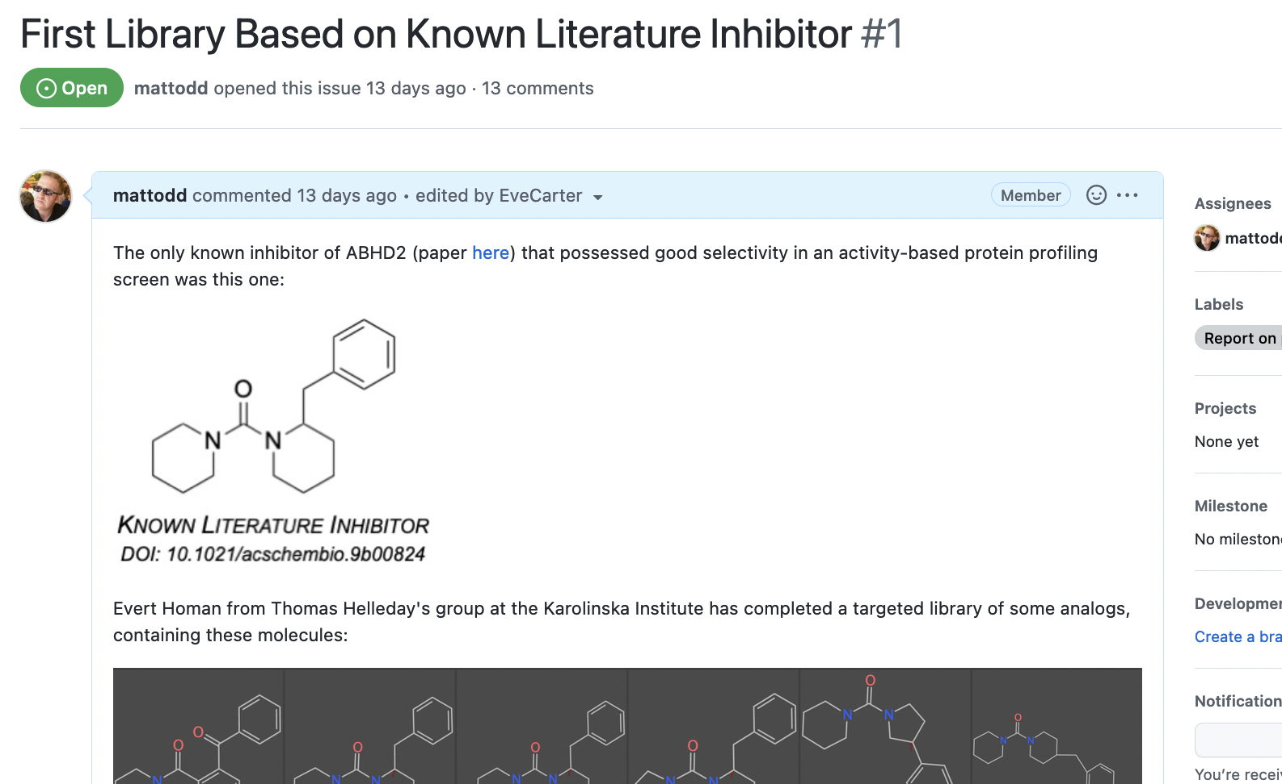
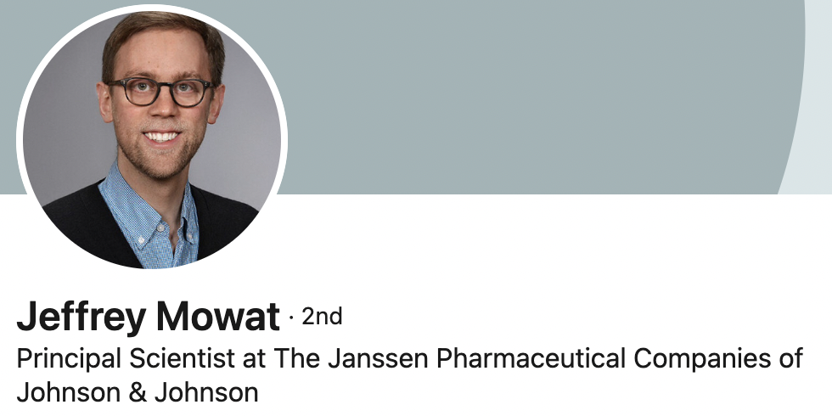
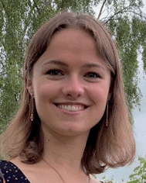
Example – ABHD2 Project: First Library Ready, Protein Coming Soon
Pharma Champion
Jeff Mowat, Janssen
Student Champion
Eve Carter, UCL
https://github.com/StructuralGenomicsConsortium/CNP6-ABHD2
Next meeting: Tuesday, Oct 18th 1pm UK at https://ucl.zoom.us/j/93595179967

